Slide 1

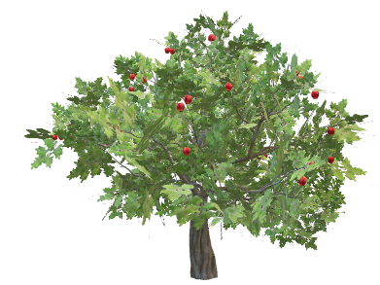
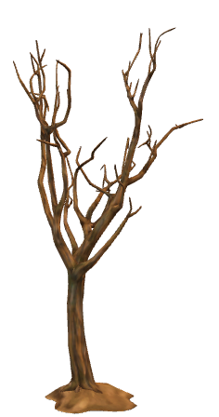
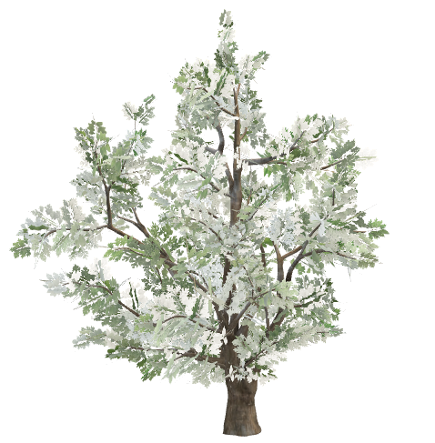
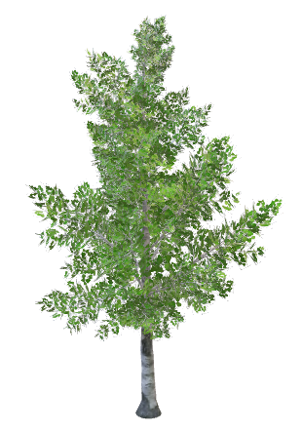
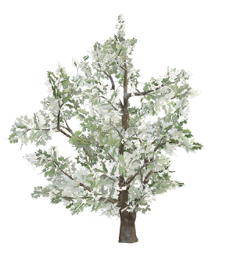
Volume of
Deadwood
Forest
Hierarchy
Biodiversity
Cultural Value
Size of
Forest
Development
of Forest
Forest
Influence
Density of
Forest
Proportion
of Forest

